Slide 1
SECURE DATA HIDING IN IMAGES USING STEGANOGRAPHY
CAPSTONE PROJECT
Student Name : Chelliboyina Hari Venkata Sai
College Name & Department :Raghu Engineering College(C.S.C)

Slide 2
OUTLINE
Problem Statement
Technology used
Wow factor
End users
Result
Conclusion
Git-hub Link
Future scope

Slide 3
Problem Statement
The given Python code implements a basic image-based steganography system using OpenCV, allowing users to securely hide and retrieve secret messages within image files.
The first script encrypts a user-inputted message into an image's pixel values and secures it with a passcode, which is stored separately.
The second script decrypts the message from the image but only allows access upon correct passcode entry. This system ensures message confidentiality and access control.

Slide 4
Technology used
Programming Language:
Python: The entire implementation is written in Python, leveraging its simplicity and vast library ecosystem.
Libraries and Modules:
OpenCV (cv2): Used for image processing, reading, modifying, and saving images.
os: Provides functions for interacting with the operating system, such as opening files and executing commands.
string: Although imported, it is not utilized in the provided code. It typically provides common string operations and constants.
Platforms:
Operating System: Designed for Windows, evident from the file paths (e.g., C:\Users\HARISH\...).
Python Environment: Requires a Python interpreter installed on the system, preferably Python 3.x for compatibility with modern libraries.
Technologies/Concepts Applied:
Steganography: The process of hiding secret information within image pixels.
File Handling: Reading and writing files, including handling passwords securely (though improvements are needed).
Basic Encryption Mechanism: Using pixel values of an image to store characters of a secret message.
Image Format:
Supports image files compatible with OpenCV, such as PNG, JPEG, etc.

Slide 5
Wow factors
Simple Steganography Implementation Using Image Pixels:
The project uniquely utilizes image pixel values (specifically RGB channels) to embed a secret message without using complex algorithms.
Password-Protected Decryption:
This code adds an extra layer of security by requiring a passcode for decryption, ensuring that only authorized users can retrieve the hidden message.
Direct Image Manipulation with OpenCV:
This project directly manipulates image pixels using OpenCV, providing users with a deeper understanding of how digital images can be altered on a low level.
Automated Password Storage:
The system automatically saves the password to a text file, which adds an element of persistence for future decryption,
making it practical for repeated use without manual password entry.
Cross-Channel Data Embedding:
The code cleverly cycles through the Red, Green, and Blue channels of the image to embed the message,
which minimizes visual distortion and reduces the risk of detection.
User-Friendly Interaction:
The program uses straightforward console prompts for entering secret messages and passwords, making it accessible for users without technical expertise.

Slide 6
End users
Cybersecurity Professionals
Government and Intelligence Agencies
Journalists and Activists
Military and Defense Organizations
Digital Forensics and Law Enforcement
Intellectual Property Protection Specialists
Healthcare Sector
Financial Institutions

Slide 7
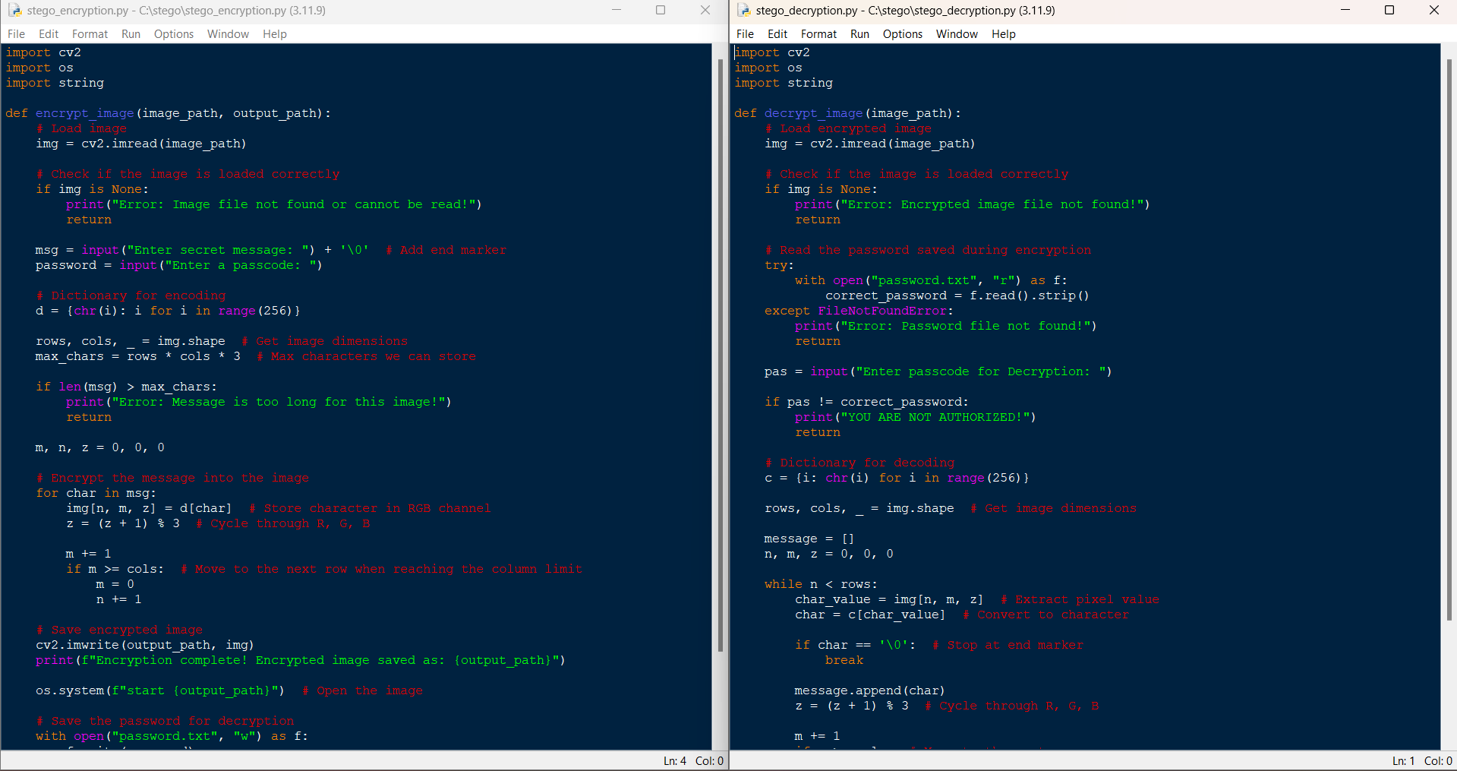
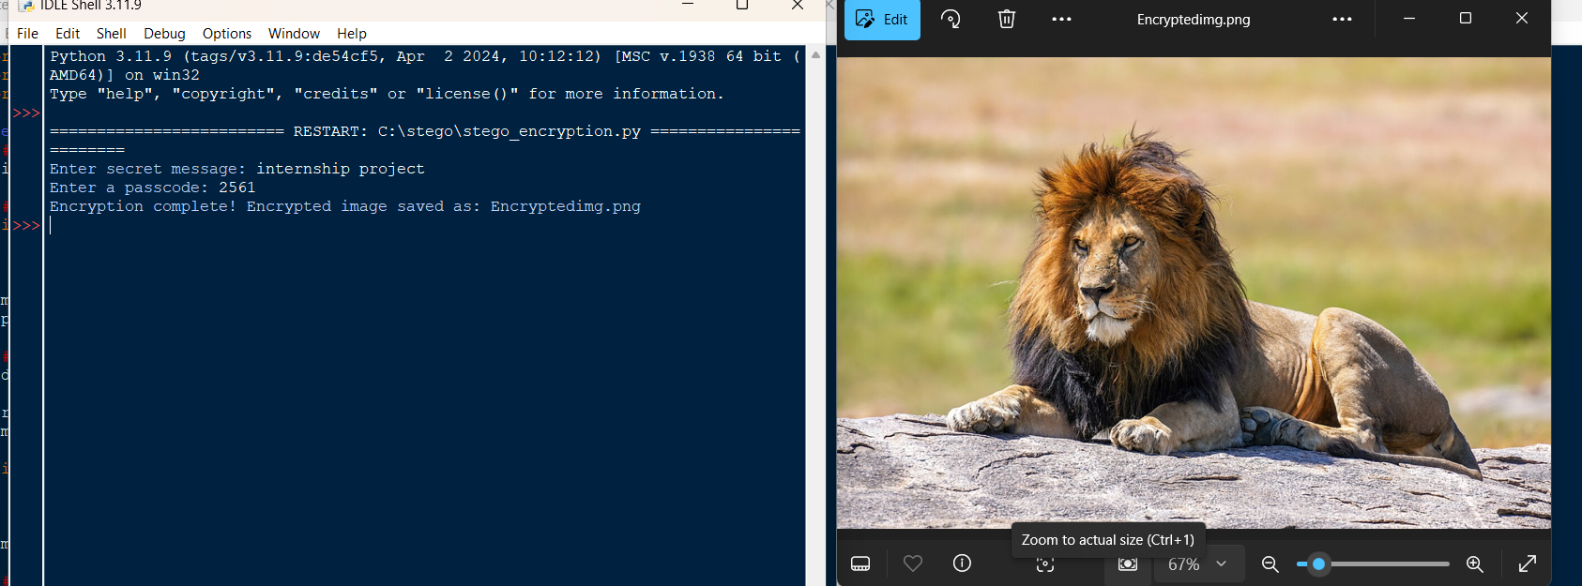
Results

Slide 8
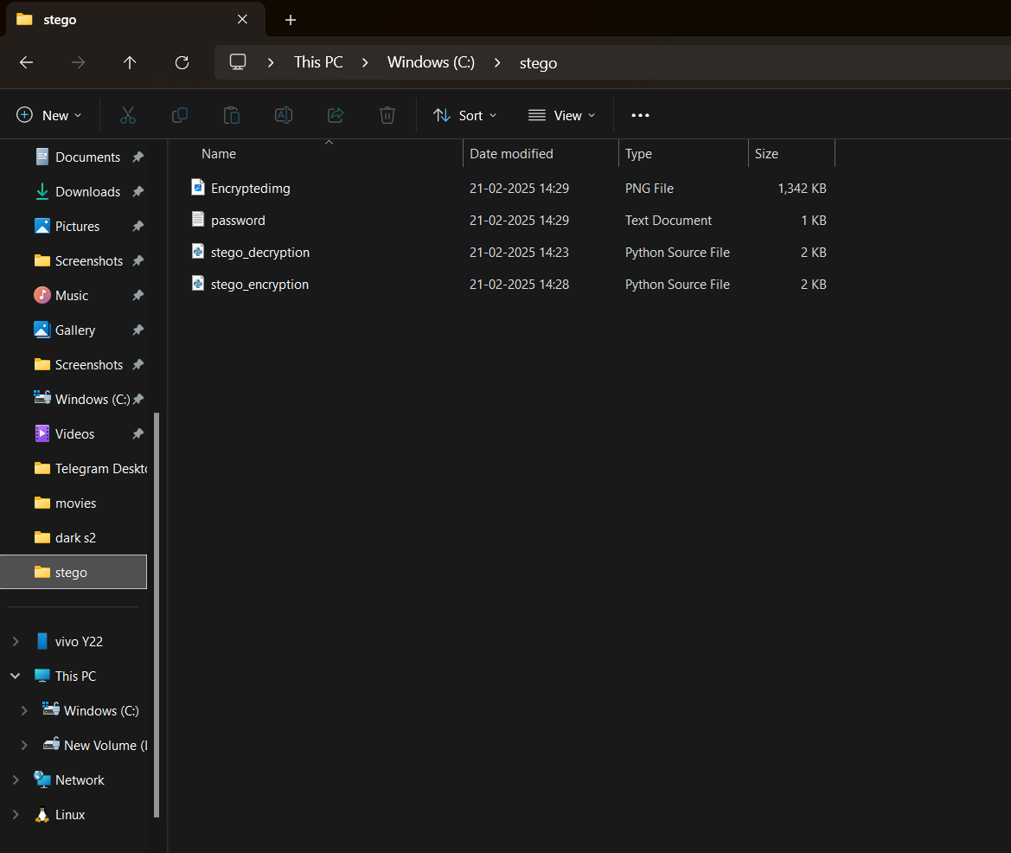
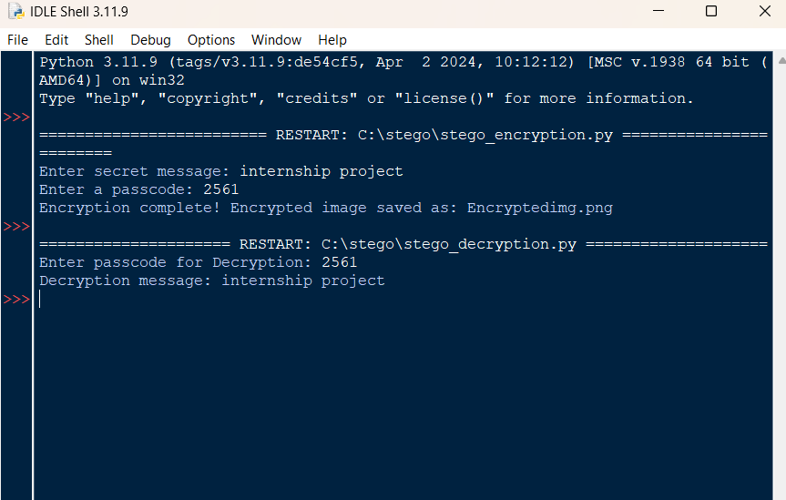
Results

Slide 9
Conclusion
This project successfully demonstrates a basic yet effective implementation of image-based steganography
using Python and OpenCV.
By embedding secret messages within the pixel values of images and securing access with a password,
the system ensures a foundational level of data confidentiality and user authorization.
The project highlights how steganography can be practically applied for secure communication,
making it valuable for educational purposes and introductory cybersecurity practices.

Slide 10
GitHub Link
https://github.com/chharish360h/aicte-internship-project1.git

Slide 11
Future scope :
Advanced Encryption Integration
Graphical User Interface (GUI)
Support for Multiple File Formats
Secure Password Storage
Mobile Application Development
Cloud Integration
Error Handling and Performance Optimization

Slide 12
THANK YOU

